Slide 1

Introduction to MATLAB
What is MATLAB?
How is it used?
Basic commands
Variables
What are variables?
How are they used in MATLAB
Scripts
What are script files?
How do we create them?
How do we run them? Arrays – Part 1
What are arrays?
Creating constant arrays
Using arrays
Arrays – Part 2
Array variables
Special arrays
Special array functions
Arrays – Part 3
Working with single elements
Working with multiple elements
by
First Year Engineering Learning Center
368 Snell Engineering Building
College of Engineering
Northeastern University

Slide 2
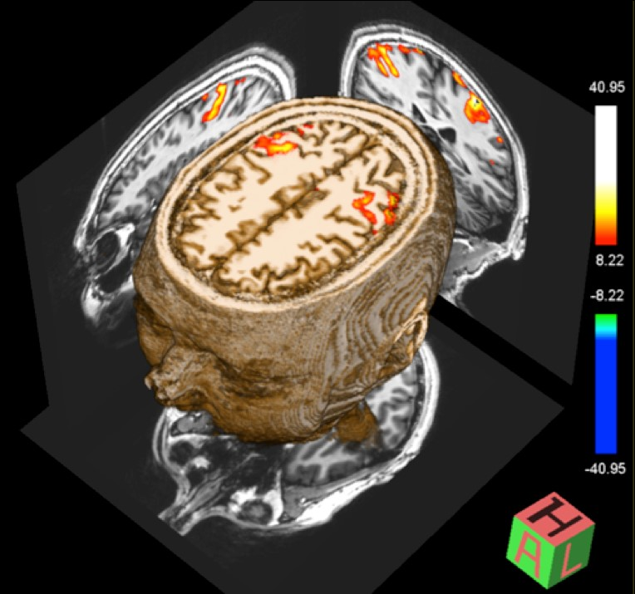
Some examples of MATLAB use:
Reconstructing functional-MRI data into 3-dimensional representations of brain activity.

Slide 3
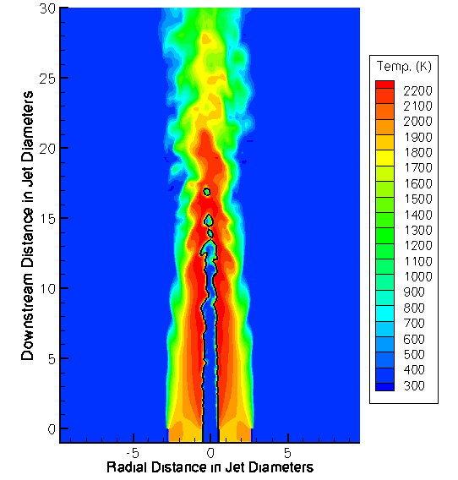
Some examples of MATLAB use:
Modeling fuel combustion in turbulent streams to reduce emissions and improve efficiencies.

Slide 4

Some examples of MATLAB use:
Examining fractal systems to expand chaos theory.

Slide 5
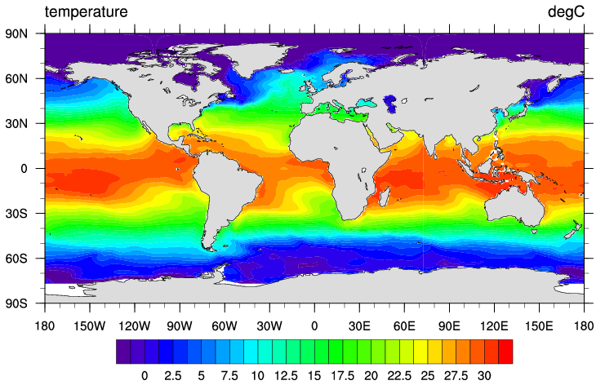
Some examples of MATLAB use:
Plotting very large datasets related to climate change and developing complex models to explore solutions

Slide 6
Basic Arithmetic:
>> 1+5-2
ans = 4
>> 3*2
ans = 6
>> 5/3
ans = 1.6667
>> format long
>> 5/3
ans = 1.666666666666667
>> format short
>> 5^2
ans = 25
>> pi
ans = 3.1416
addition and subtraction
multiplication
division
turns on display of more digits
calculations remain as precise, this just
reduces what is displayed on screen
exponentiation
constants

Slide 7
Basic Arithmetic, cont’d:
>> ((10.1 + 1.9) / 3) + 1e2
ans = 104
>> 7+8/2
ans = 11
>> (7+8)/2
ans = 7.5000
>> (-1) ^ (1/2)
ans = 0.0000 + 1.0000i
>> (1+i) + (1–3i)
ans = 2.0000 - 2.0000i
>> 1.2e2
ans = 120
>> 1.2e-2
ans = 0.0120
Parentheses can be used to set the
order of operations. Use them to
make sure that MATLAB is doing the
math you wanted it to do!
MATLAB knows imaginary numbers!
(Remember $x^{1/2}=\sqrt{x}$)
e is a shorthand way to use scientific notation.
It is equivalent to: * 10^

Slide 8
Built-In Trigonometry Functions:
>> sin(0)
ans = 0
>> cos(0)
ans = 1
>> tan(130)
ans = 2.5323
>> asin(0)
ans = 0
>> acos(0)
ans = 1.5708
>> acos(0)/(pi/180)
ans = 90
>> acosd(0)
ans = 90
>> sind(270)
ans = -1
all the usual trig functions are built in
the inverse trig functions (they are also
called arcsine, arccosine, etc.)
That result for acos(0) may have surprised you. MATLAB uses radians by default. You can convert degrees↔radians using pi/180, or you can use the trig functions with a d at the end to specify working in degrees

Slide 9
Some Other Built-In Math:
>> exp(2)
ans = 7.3891
>> log(100)
ans = 4.6052
>> log10(100)
ans = 2
>> abs(-3.1)
ans = 3.1000
>> sqrt(81)
ans = 9
>> sqrt((3^2) + (4^2))
ans = 5
>> hypot(3,4)
ans = 5
exp() is the same as e^(); the inverse of the natural log
the natural log (MATLAB does not call it ln)
the base-10 logarithm
the absolute value
the square root [an alternative to ^(1/2)]
finding the hypotenuse of a triangle using Pythagorean’s theorem
a built-in function to do the same as the above;
note how this function uses two inputs

Slide 10
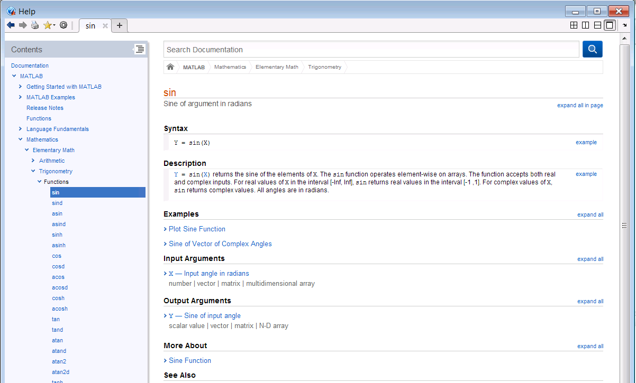
Getting Help:
MATLAB’s built-in help is very extensive
doc brings up a very useful help file for any command
>> doc sin

Slide 11
(Scalar) Variables:
>> x=-3
x = -3
>> 2*x+1
ans = -5
>> x=1.1
x = 1.1
>> 2*x+1
ans = 3.2
>> y=x+0.9
y = 2
>> y^2
ans = 4
>> y=y+1
y = 3
= to set the value of x
once a value is set for x, MATLAB replaces every instance of x with its value
using = again sets a new value
The right-hand-side of the equals sign is evaluated first, so this is valid!

Slide 12
(Scalar) Variables:
>> x
ans = 1.1
>> y
ans = 3
>> x+2*y
ans = 7.1
>> clear y
>> x
ans = 1.1
>> y
undefined function or variable ‘y’
>> x+y
undefined function or variable ‘y’
the values of x and y are set and can be used
but if we clear (erase) the value of y, we cannot use it anymore

Slide 13
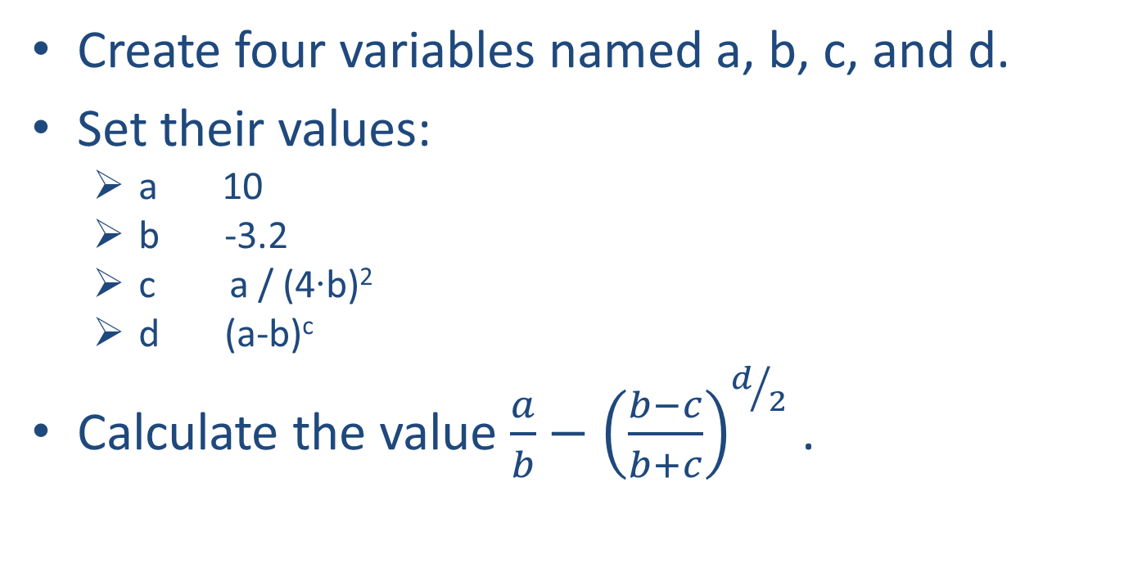
Problem*:
Create four variables named a, b, c, and d.
Set their values:
a 10
b -3.2
c a / (4∙b)²
d (a-b)^{c}
Calculate the value $\frac{a}{b}−{\left(\frac{b−c}{b+c}\right)}^{d/2}$ .
>> edit vals_problem
(click yes when asked if you want to create this file)

Slide 14
vals_problem.m:
Type these commands into the editor window.
Then, save the file (Save button on the toolbar or Ctrl-s [Cmd-s on Mac])
% This script performs the calculation on
% slide 4.
a = 10;
b = -3.2;
c = a/((4*b)^2);
d = (a-b)^c;
(a/b) – (((b-c)/(b+c))^(d/2))
Lines starting with %
are comments and
are ignored.
Note the semicolons at the ends of these lines. They are optional, but I’ve put them here so that we don’t see the results of these lines when the program runs.
No semicolon here, because the result of this calculation is what I want the program to display!

Slide 15
Script Files:
Running a script file is done by typing the name of the file in the Command Window.
The script file must be in the Current Folder.
Running the script file is the same as if you typed each command from the script one-by-one in the Command Window.
>> vals_problem
ans = -4.1476

Slide 16
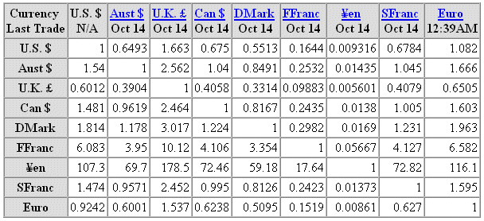
What is an Array?
An array is a collection of values, all using the same variable name. They are like an Excel worksheet, where one file can store many values.

Slide 17
What is an Array?
An array can be 1-dimensional, like a single column or row of data, or it can be 2-dimensional like a worksheet.

Slide 18
Creating 1-D constant arrays*:
>> [0 5 -2 3.14]
ans = 0 5 -2 3.14
>> [1,10,5,-1]
ans = 1 10 5 -1
>> [18;1;-4]
ans = 18
1
-4
>> [18,1,-4]'
ans = 18
1
-4
commas and spaces are equivalent; both separate elements in a row
semicolons separate rows
an apostrophe does the transpose, meaning change rows to columns and vice-versa

Slide 19
Creating 1-D arrays*:
>> 1:5
ans = 1 2 3 4 5
>> 30:10:60
ans = 30 40 50 60
>> 6.5:-2.5:-1
ans = 6.5 4 1.5 -1
>> linspace(0,1,4)
ans = 0 0.3333 0.6667 1
>> linspace(-2,2,5)
ans = -2 -1 0 1 2
>> logspace(-1,1,5)
ans = 0.1 0.3162 1 3.162 10
a:b is equivalent to the row array:
[a a+1 a+2 … b]
a:step:b is equivalent to:
[a a+step a+2*step … b]
linspace(init, final, num_el) creates a row array from init to final with num_el elements
logspace(init, final, num_el) creates a row array from 10^init to 10^final with num_el elements, spaced logarithmically

Slide 20
Creating 2-D arrays*:
>> [5, 24, 12; 7, 11, 9; 4, 7, 97; 6, 25, 98]
ans = 5 24 12
7 11 9
4 7 97
6 25 98
>> [1, 2, 3; 1, 2]
Error...
>> [1:5; linspace(0,8,5); 5:-1:1]
ans = 1 2 3 4 5
0 2 4 6 8
5 4 3 2 1
create a 2-D array by separating elements within a row using a comma or space and starting a new row with a semicolon
there must be the same number of elements in each row and in each column!
rows can be any 1-D row array

Slide 21
Using arrays in functions*:
Many times, arrays can be used in a function just like a scalar. The output is an array of results.
>> linspace(0, 2*pi, 5)
ans = 0 1.5708 3.1416 4.7124 6.2832
>> 1 + linspace(0, 2*pi, 5)
ans = 1 2.5708 4.1416 5.7124 7.2832
>> sin(linspace(0, 2*pi, 5))
ans = 0 1 0 -1 0
>> cos(linspace(0, 2*pi, 5))
ans = 1 0 -1 0 1
>> linspace(0, 2*pi, 5) < pi
ans = 1 1 0 0 0

Slide 22
Array Variables
In MATLAB, every variable is an array.
Scalar variables are just a 1-element array!
Arrays can change size at any time in MATLAB.
Array sizes can be as large as you like, until the computer runs out of memory!

Slide 23
Creating array variables:
>> x=1:5
x = 1 2 3 4 5
>> x
x = 1 2 3 4 5
>> y=[10:-1:7]'
y = 10
9
8
7
>> A=[5, 24, 12; 7, 11, 9; 4, 7, 97; 6, 25, 98]
A = 5 24 12
7 11 9
4 7 97
6 25 98
the name of an array by itself refers to
the entire array of values

Slide 24
Creating array variables*:
>> clear x
>> x(1)=2
x = 2
>> x(2)=-3
x = 2 -3
>> x(4)=pi
x = 2 -3 0 3.1416
>> x(4)=5
x = 2 -3 0 5
>> x(1)=[]
x = -3 0 5
setting the value of the 1st element
setting the value of the 2nd element—array automatically resizes to fit
setting the value of the 4th element (default value of 0 given to 3rd element)
changing the value of the 4th element
setting an element equal to an empty array, [], deletes it from the array

Slide 25
Creating array variables *:
For 2-D arrays,
2 indexes in parentheses: (row, column)
>> B(1,1)=2
B = 2
>> B(2,2)=-3
B = 2 0
0 -3
>> B(1,2)=1.2
B = 2 1.2
0 -3
setting the value of the element in the 1st row, 1st column
setting the value of the element in the 2nd row, 2nd column (default value of 0 given to the two “missing” elements)
setting the value of the element in the 1st row, 2nd column

Slide 26
Some special arrays*:
>> Z=zeros(4,2)
Z = 0 0 0 0 0 0 0 0 >> O=ones(2,5)
O = 1 1 1 1 1
1 1 1 1 1
>> E=eye(3)
E = 1 0 0
0 1 0
0 0 1
>> M=magic(3)
M = 8 1 6
3 5 7
4 9 2
a 4 rows × 2 columns array of zeros
a 2 rows × 5 columns array of ones
a 3 × 3 identity matrix (useful in linear algebra)
a 3 × 3 magic square (not commonly useful)

Slide 27
Some special arrays:
>> F = -5*ones(4,2)
F = -5 -5 -5 -5 -5 -5 -5 -5 >> W = 3*ones(1000,1000) - 2*eye(1000)
W = 1 3 3 ... 3
3 1 3 ... 3
3 3 1 ... 3
. . .
. . .
. . .
3 3 3 ... 1

Slide 28
Some special functions for arrays*:
>> A = [1, 2, 3, 4, 5]
A = 1 2 3 4 5
>> B = [1, 2, 3; 4, 5, 6]
B = 1 2 3
4 5 6
>> size(A)
ans = 1 5
>> size(B)
ans = 2 3
>> numel(A)
ans = 5
>> numel(B)
ans = 6
size() returns a row vector [m,n] where m & n are the numbers of rows (m) and columns (n) of the array
numel() returns the total number of elements in an array (equal to m*n as discussed above)
Other useful functions can get statistics on array values, e.g. max() & mean().

Slide 29
Working with single array elements:
For 1-D row or column array,
Index in parentheses after name of array
>> x = [2,-3,0,pi]
x = 2 -3 0 3.1416
>> 4+x(1)
ans = 6
>> x(1)+x(2)
ans = -1
>> cos(x(4))
ans = -1
using the value of the various individual elements

Slide 30
Working with single array elements:
For 2-D arrays,
2 indexes in parentheses: (row, column)
>> B=[2, 1.2; 0, -3]
B = 2 1.2
0 -3
>> cos(B(2,1))
ans = 1
>> B(1,2)+B(2,2)
ans = -1.8
>> B(3,1)
Index exceeds matrix dimensions
use array elements like any other variable
you can’t use array elements that don’t exist!

Slide 31
Working with multiple array elements, 1-D arrays*:
>> x=linspace(-2,2,2)
x = -2 -1 0 1 2
>> x([1 2])
ans = -2 -1
>> x(2:4)
ans = -1 0 1
>> x(2:4)=[0 0 0]
x = -2 0 0 0 2
>> x(1:3)=[]
x = 0 2
>> y=-5:5;
>> y(8:end)
ans = 2 3 4 5
>> y(1:2:end)
ans = -5 -3 -1 1 3 5
using an array for the index value in the parentheses lets you read or set the value of multiple elements
setting multiple elements equal to an empty array, [], deletes them from the array
end can be used to refer to the last element index

Slide 32
Working with multiple array elements, 2-D arrays*:
>> A=[1:5; linspace(0,8,5); 5:-1:1]
A = 1 2 3 4 5
0 2 4 6 8
5 4 3 2 1
>> A(2, 1:3)
ans = 0 2 4
>> A(1:2, 1:2)=[0, 0; 0, 0]
A = 0 0 3 4 5
0 0 4 6 8
5 4 3 2 1
>> A(2,:)
ans = 0 0 4 6 8
>> A(:,2)
ans = 0
0
4
using an array for index values lets you read or set the value of multiple elements
a colon without numbers represents “all of the rows” or “all of the columns”

Slide 33
Combining array elements*:
Arrays can be built by combining arrays, adding columns with a comma or space and rows with a semicolon
>> x = [0,2]
x = 0 2
>> y = [x,x,1]
y = 0 2 0 2 1
>> y = [x'; x';1]
y = 0
2
0
2
1
>> y = [x', x']
y = 0 0
2 2

